Slide 1
CS35L - 5
Week 4 Lec 2

Slide 2
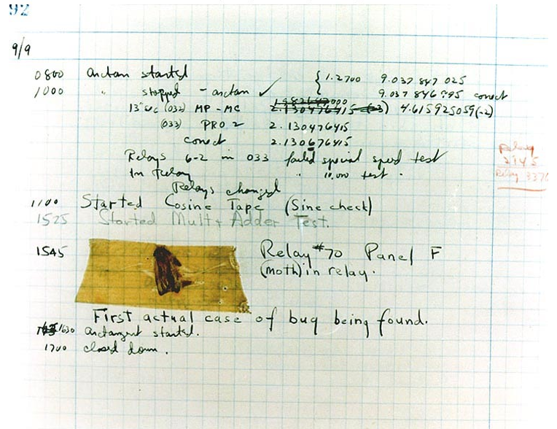
Debugging
Finding and eliminating errors from programs
Grace Hopper and the “First actual case of bug being found”

Slide 3
Debugging Process
Reproduce the bug
Simplify program input
Use a debugger to track down the origin of the problem
Fix the problem

Slide 4
Run-Time Errors
Segmentation fault
Program received signal SIGSEGV, Segmentation fault. 0x0000000000400524 in function (arr=0x7fffc902a270, r1=2, c1=5, r2=4, c2=6) at file.c:12
Line number where it crashed and parameters to the function that caused the error
Logic Error
Program will run and exit successfully
How do we find bugs?

Slide 5
Debugger
A program that is used to run and debug other (target) programs
Advantages:
Programmer can:
step through source code line by line
each line is executed on demand
interact with and inspect program at run-time
If program crashes, the debugger outputs where and why it crashed

Slide 6
GDB – GNU Debugger
Debugger for several languages
C, C++, Java, Objective-C… more
Allows you to inspect what the program is doing at a certain point during execution
Logical errors and segmentation faults are easier to ﬁnd with the help of gdb

Slide 7
Using GDB
Compile Program
Normally: $ gcc [flags] <source files> -o <output file>
Debugging: $ gcc [other flags] –g <source files> -o <output file>
enables built-in debugging support
Specify Program to Debug
$ gdb <executable>
or
$ gdb
(gdb) file <executable>

Slide 8
Using GDB
3. Run Program
(gdb) run or
(gdb) run [arguments]
4. In GDB Interactive Shell
Tab to Autocomplete, up-down arrows to recall history
help [command] to get more info about a command
5. Exit the gdb Debugger
(gdb) quit

Slide 9
Setting Breakpoints
Breakpoints
used to stop the running program at a specific point
If the program reaches that location when running, it will pause and prompt you for another command
Example:
(gdb) break file1.c:6
Program will pause when it reaches line 6 of file1.c
(gdb) break my_function
Program will pause at the first line of my_function every time it is called
(gdb) break [position] if expression
Program will pause at specified position only when the expression evaluates to true

Slide 10
Conditional Breakpoints
break [position] if expression
(gdb) s
27 for ( i = 1; i <= limit ; ++i )
(gdb) break 28 if i == limit - 1
Breakpoint 1 at 0x4010e7: file gdb_test.c, line 28.

Slide 11
Breakpoints
Setting a breakpoint and running the program will stop program where you tell it to
You can set as many breakpoints as you want
(gdb) info breakpoints|break|br|b shows a list of all breakpoints

Slide 12
Deleting, Disabling and Ignoring BPs
(gdb) delete [bp_number | range]
Deletes the specified breakpoint or range of breakpoints
(gdb) disable [ bp_number | range]
Temporarily deactivates a breakpoint or a range of breakpoints
(gdb) enable [ bp_number | range]
Restores disabled breakpoints
If no arguments are provided to the above commands, all breakpoints are affected!!
(gdb) ignore bp_number iterations
Instructs GDB to pass over a breakpoint without stopping a certain number of times.
bp_number: the number of a breakpoint
Iterations: the number of times you want it to be passed over

Slide 13
Displaying Data
Why would we want to interrupt execution?
to see data of interest at run-time:
(gdb) print [/format] expression
Prints the value of the specified expression in the specified format
Formats:
d: Decimal notation (default format for integers)
x: Hexadecimal notation
o: Octal notation
t: Binary notation

Slide 14
Resuming Execution After a Break
continue [ passes] , c [ passes]
Allows the program to run until it reaches another breakpoint, or until it exits if it doesn't encounter any further breakpoints. The passes argument is a number that indicates how many times you want to allow the program to run past the present breakpoint before GDB stops it again. This is especially useful if the program is currently stopped at a breakpoint within a loop.
step [ lines] , s [ lines]
Go to the next instruction (source line), diving into the function. Do it lines number of times.
next [ lines] , n [ lines]
Works the same way as step, except doesn’t dive into the functions i.e. treats subroutine as one instruction. Do it lines number of times.
finish
To resume execution until the current function returns, use the finish command. The finish command allows program execution to continue through the body of the current function, and stops it again immediately after the program flow returns to the function's caller. At that point, GDB displays the function's return value in addition to the line containing the next statement.

Slide 15
Watchpoints
Watch/observe changes to variables
(gdb) watch my_var
sets a watchpoint on my_var
the debugger will stop the program when the value of my_var changes
old and new values will be printed
(gdb) rwatch expression
The debugger stops the program whenever the program reads the value of any object involved in the evaluation of expression

Slide 16
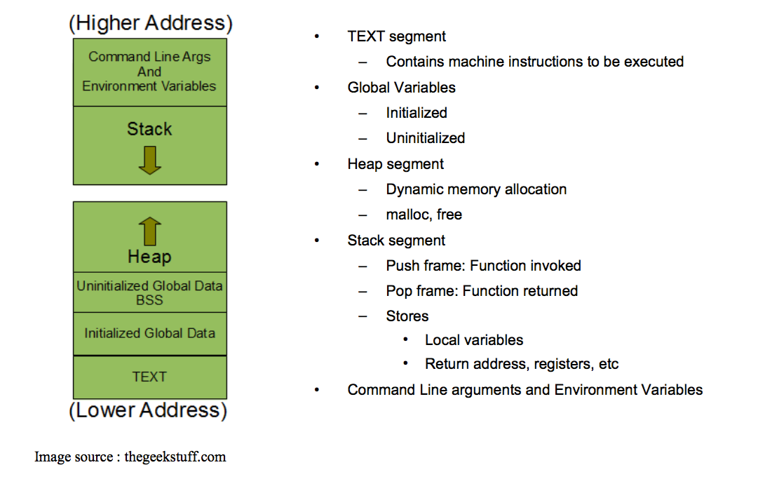
Process Memory Layout

Slide 17
Stack Info
A program is made up of one or more functions which interact by calling each other
Every time a function is called, an area of memory is set aside for it. This area of memory is called a stack frame and holds the following crucial info:
storage space for all the local variables
the memory address to return to when the called function returns
the arguments, or parameters, of the called function
Each function call gets its own stack frame. Collectively, all the stack frames make up the call stack

Slide 18
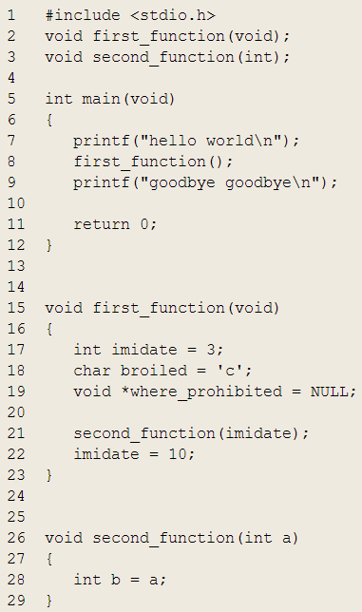
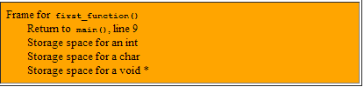

Stack Frames and the Stack

Slide 19
Analyzing the Stack in GDB
(gdb) backtrace|bt
Shows the call trace (the call stack)
Without function calls:
#0 main () at program.c:10
one frame on the stack, numbered 0, and it belongs to main()
After call to function display()
#0 display (z=5, zptr=0xbffffb34) at program.c:15
#1 0x08048455 in main () at program.c:10
Two stack frames: frame 1 belonging to main() and frame 0 belonging to display().
Each frame listing gives
the arguments to that function
the line number that's currently being executed within that frame

Slide 20
Analyzing the Stack
(gdb) info frame
Displays information about the current stack frame, including its return address and saved register values
(gdb) info locals
Lists the local variables of the function corresponding to the stack frame, with their current values
(gdb) info args
List the argument values of the corresponding function call

Slide 21
Other Useful Commands
(gdb) list
Lists source code lines around the current line
Ref: http://darkdust.net/files/GDB%20Cheat%20Sheet.pdf

Slide 22
Lab 4
Download old version of coreutils with buggy ls program
Untar, configure, make
Bug: ls -t mishandles files whose time stamps are very far in the past. It seems to act as if they are in the future
$ touch -d ‘1918-11-11 11:00 GMT’ wwi-armistice
$ touch now
$ sleep 1
$ touch now1
$ ls -lt wwi-armistice now now1
Output:
-rw-r--r-- 1 eggert eggert 0 Nov 11 1918 wwi-armistice
-rw-r--r-- 1 eggert eggert 0 Feb 5 15:57 now1
-rw-r--r-- 1 eggert eggert 0 Feb 5 15:57 now

Slide 23
Goal: Fix the Bug
Reproduce the Bug
Follow steps on lab web page
Simplify input
Run ls with –l and –t options only
Debug
Use gdb to figure out what’s wrong
$ gdb ./ls
(gdb) run –lt wwi-armistice now now1
(run from the directory where the compiled ls lives)
Patch
Construct a patch “lab5.diff” containing your fix
It should contain a ChangeLog entry followed by the output of diff -u

Slide 24
Lab Hints
Don’t forget to answer all questions! (lab4.txt)
Make sure not to submit a reverse patch! (lab4.diff)
“Try to reproduce the problem in your home directory, instead of the $tmp directory. How well does SEASnet do?”
Timestamps represented as seconds since Unix Epoch
SEASnet NFS filesystem has unsigned 32-bit time stamps
Local File System on Linux server has signed 32-bit time stamps
files have to be touched on local filesystem: check df –l
Use “info functions” to look for relevant starting point

Slide 25
Homework 4 Hints
Write a C program called sfrob
Reads stdin byte-by-byte (getchar)
Consists of records that are newline-delimited
Each byte is frobnicated (XOR with dec 42)
Sort records without decoding (qsort, frobcmp)
Output result in frobnicated encoding to stdout (putchar)
Error checking (fprintf)
Dynamic memory allocation (malloc, realloc, free)

